Slide 1
LUNG CANCER PREDICTION USING PREDICTIVE ANALYTICS

Slide 2
STUDENT DETAILS:
Nandhisha S
Nivetha M
Sudha P
GUIDE DETAILS:
Mr.Sathish.R AP/IT

Slide 3
ABSTRACT
Our body is made up of hundred million of million cells .Cancer which can be defined as that a disease in which an abnormal cells divide uncontrollably and destroy body tissue. Lung cancer is the most common killer and which plays an important roles in mortality of vast amount of people.About 234,030 new cases have lung cancer in which 121,680 were men and 112,350 were women ; About 154,050 deaths due to lung cancer in which 83,550 men and 70,500 were women.There are two types of lung cancer which are as follows as: small cell lung cancer and non-small cell lung cancer.Our approach which provides the therapist to make use of this analysis for further reference to be aware about the lung cancer .We analyzed the lung cancer prediction using classification algorithm such as Naive Bayes, Bayesian network and J48 algorithm.. The main aim of this is to provide the earlier warning to the users about lung cancer.

Slide 4
Lung Cancer Risk Prediction Model Incorporating Lung Function-David C. Muller, Mattias Johansson, and Paul Brennan
As the result of common incidence and poor prognosis, lung cancer is responsible for more than 1.5 million deaths worldwide each year.In particular, we investigated sex, variables related to smoking history and addiction to nicotine, personal medical history, family history of lung cancer, and lung function assessed by spirometry (ie, FEV1).To calculate the probability of lung cancer in the presence of the competing risk of death, we separately modeled the hazard of lung cancer and the hazard of death from all causes. We used ﬂexible parametric survival models on the cumulative hazard scale to estimate baseline hazards and hazard ratios.Participants with missing data on any of the covariates were excluded from the primary analyses, and sensitivity analyses on the basis of multiply imputed data were conducted. By concluding this,a risk prediction model that includes lung function has strong predictive ability, which could improve eligibility criteria for lung cancer screening programs.

Slide 5
Lung cancer prediction from microarray data by gene expression programming-Hasseeb Azzawi,Jingyu Hou,Yong Xiang,RussulAlanni
Deakin University, Australia
; Yong Xiang ; Russul Alanni
Deakin University, Australia
; Jingyu Hou ; Yong Xiang ; Russul Alanni
Lung cancer is a leading cause of cancer-related death worldwide. The early diagnosis of cancer has demonstrated to be greatly helpful for curing the disease effectively. Microarray technology provides a promising approach of exploiting gene profiles for cancer diagnosis. In this study, the authors propose a gene expression programming (GEP)-based model to predict lung cancer from microarray data. The authors use two gene selection methods to extract the significant lung cancer related genes, and accordingly propose different GEP-based prediction models. Reliability was assessed by the cross-data set validation. The experimental results show that the GEP model using fewer feature genes outperformed other models in terms of accuracy, sensitivity, specificity and area under the receiver operating characteristic curve. It is concluded that GEP model is a better solution to lung cancer prediction problems.

Slide 6
Predicting Outcomes of Nonsmall Cell Lung Cancer Using CT Image Features-
Our body is made up of hundred million of million cells .Cancer which can be defined as that a disease in which an abnormal cells divide uncontrollably and destroy body tissue. Lung cancer is the most common killer and which plays an important roles in mortality of vast amount of people.About 234,030 new cases have lung cancer in which 121,680 were men and 112,350 were women ; About 154,050 deaths due to lung cancer in which 83,550 men and 70,500 were women.There are two types of lung cancer which are as follows as: small cell lung cancer and non-small cell lung cancer.Our approach which provides the therapist to make use of this analysis for further reference to be aware about the lung cancer .This also gives a brief analysis about the lung cancer by using a data set which could be used for this purpose. This also provide the information about the patients who have most preferences to have lung cancer.

Slide 7
Tobacco smoking induced lung cancer prediction-B.J Bipin Nair, K J Anju, A Jeeva Kumar,
Cancer is deadly, a genetic disorder in which invoke uncontrolled growth of living cells in a particular region. Cancer is usually invoked by many natural causes like exposure to UV rays, smoking tobacco, oil fogs, and exposure to radioactive frequencies. In this work, we concentrate on tobacco-induced lung cancer. There are many existing systems to detect lung cancer. But none are efficient enough to prevent it before it spreads. In this work, we propose an efficient tool to analyze the possibility of getting affected by Non-Small Cell Lung Cancer (NSCLC) by comparing Lung Cancer microRNAs (LC-miRNAs) structures. Here we use global optimal alignment and TargetScan for target comparison and binding location detection. A previous research showed that major lung cancer genes are targeted by 8 type miRNAs. From this work, we concluded that use of computational techniques in miRNA and sequence analysis can reduce the cost of research and increase the accuracy.

Slide 8
Early detection and prediction of Lung Cancer survival-Rajneet Kaur
The early detection of the lung cancer is a challenging problem,due to the structure of cancer cells,where most of the cells are overlapped with each other.Classification is the most important part.It is a computational procedure that sorts images into groups according to their similarities.In this paper,Histogram Equalization is used for preprocessing of the images and feature extraction process and neural network classifier to check the state of a patient in its early stage whether it is normal or abnormal. After that we predict the survival rate of a patient by extracted features. Experimental analysis is made with data set to evaluate the performance of the different classifiers.The performance is based on the correct and incorrect classification of the classifiers.All the experiments are conducted in WEKA data mining tool.

Slide 9
Applications of Machine Learning in Cancer Prediction
and Prognosis
Joseph A. Cruz, David S. Wishart
Machine Learning is frequently used in cancer diagnosis and detection. More recently machine learning has been applied to cancer prognosis and prediction. This latter approach is particularly interesting as it is part of a growing trend towards personalized, predictive medicine. In assembling this review we conducted a broad survey of the different types of machine learning methods being used, the types of data being integrated and the performance of these methods in cancer prediction and prognosis.machine learning methods can be used to substantially (15-25%) improve the accuracy of predicting cancer. It is also evident that machine learning is also helping to improve our basic understanding of cancer development and progression.

Slide 10
Predicting lung cancer prognosis using machine learning-Talha khan burki
A machine-learning model can be used to predict survival for patients with non-small-cell lung cancer (NSCLC), according to a new study. Kun-Hsing Yu and colleagues (Stanford, CA, USA) used 2186 histopathology whole-slide images of lung adenocarcinoma and squamous-cell carcinoma patients from The Cancer Genome Atlas and 294 images from the Stanford Tissue Microarray database for validation. They used image analysis software to extract a further 9879 quantitative image features. Machine-learning software assessed these images, and developed classifiers that could identify tumour cells, differentiate between adenocarcinoma and squamous cell carcinoma, and predict survival.

Slide 11
EXISTING SYSTEM
•Lung cancer detection which are being done by manual method only in past years .
•It consume large amount of time.

Slide 12
PROPOSED SYSTEM
•Our approach which can be done by predicting through all collecting the historic data which is known to be as data sets.
•Our approach which makes time consuming method through the analysis which could be used for future reference for determining the ratio about lung cancer.

Slide 13
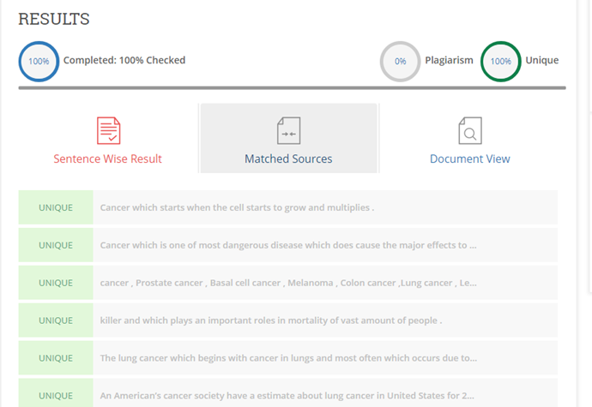
PLAGIARISM REPORT

Slide 14
THANK YOU

